Slide 1
Proliferation of Ransomware and the Impact of Geopolitical Events
Lauren Proehl

Slide 2


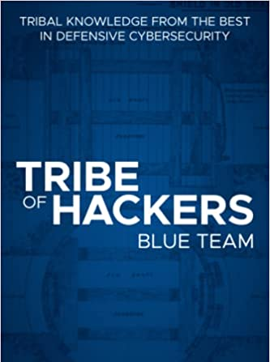
Introduction
2015
Graduated from Telecommunications System Management (TSM)
2015
SOC analyst @ MSSP
2018
Incident Response and Threat Hunting @ Major Telco
2020
Leading Threat Intelligence and Threat Hunting @ MMC
2021
Added leading SOC and Security Automation @ MMC
2022
Manager of Global Cyber Defense @ MMC
Trail running
Gravel biking
Traveling
Cheering for MSU during March Madness
Notes:
Two highlight pieces and move on

Slide 3
Agenda
General Threat Landscape
Ransomware
Geopolitical Shifts
Questions
All resources will be provided at the end of the talk

Slide 4
Let’s get on the same page
What is cyber threat intelligence?
Refined information on cyber threats that help consumers make better decisions about their defense posture
Why does threat intelligence matter?
It can help you proactively address threats and be more prescriptive in your security program investments
What is the “threat landscape” exactly?
A collection of all potential or identified cyber threats in a particular domain or context

Slide 5



Audience Considerations
Notes:
I am going to cover these topics from a student interest level, a SMB level, and a industry/community level

Slide 6


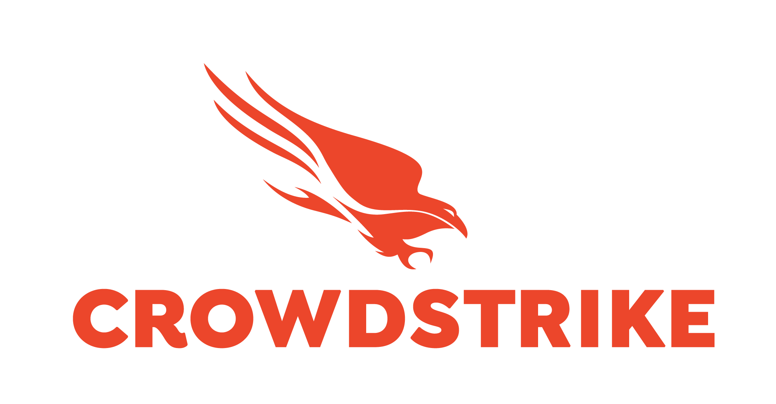

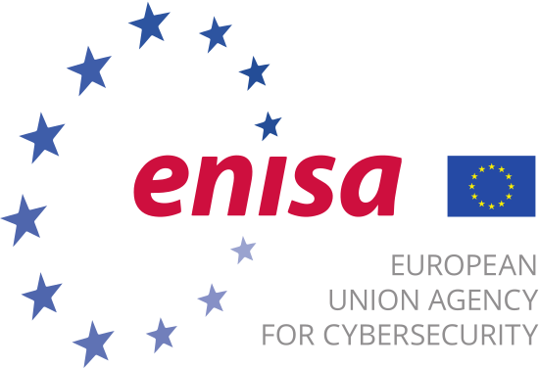

Threat Landscape
Global
Cross industry
2021/2022
Major trends, findings, and opportunities
But how do we get this?

Slide 7





Key Threat Landscape Findings
Attackers are using mostly open source tools
Financial gain is still the primary motivation
Supply chain attacks are on the rise
Ransomware and extortion still poses the greatest risk
Vulnerability exploitation is on the rise

Slide 8
Open and Common Attack Tools - Defenses
Ensure you are using enterprise security tools
Block known risky registrars, TLDs, and more, depending on your business model
Top TLDs
.xyz
.icu,
.top
.infor
Top ASNs
AS45090 Shenzhen Tencent Computer Systems Co., Ltd.
AS37963 Hangzhou Alibaba Advertising Co., Ltd.
AS20473 The Constant Company, LLC
Understand how the tool operates
Research detection methods for top tools
Mimikatz
Metasploit
PowerSploit
Cobalt Strike
Bloodhound
Harden standard operating system image for all hosts
Bonus: lockdown Active Directory
Notes:
2a, https://www.bleepingcomputer.com/news/security/these-are-the-top-level-domains-threat-actors-like-the-most/ / https://www.spamhaus.org/statistics/tlds/
2b. Sophos report - cobalt strike beacons ASN - https://www.sophos.com/en-us/labs/security-threat-report
5. https://isc.sans.edu/forums/diary/Mitigations+against+Mimikatz+Style+Attacks/24612/
.xyz .icu, .ru, .cn, .uk, .tk, .ga, .ml, .pw, .top, .gq, .info, .cf
Top ASNs - AS45090 Shenzhen Tencent Computer Systems Co., Ltd., AS37963 Hangzhou Alibaba Advertising Co., Ltd., and AS20473 The Constant Company, LLC

Slide 9
Supply Chain Attacks - Defenses
Understand who your customers are and who your vendors are
Government
Critical Infrastructure
Large F500 organizations
Document all vendors and software in your ecosystem
Employ least privilege permissions for vendors
Check for breach language in all contracts
Research historic supply chain attacks
Solarwinds
Kaseya
Okta
Pay special attention to MSP relationships
Individual targeting can happen

Slide 10
Vulnerability Exploitation - Defenses
Ensure you are prioritizing patches for external facing assets
Don’t just rely on CVSS
Patch most common exploited CVEs first
CISA Known Exploited Vulnerabilities (KEV)
Remote access applications, Exchange, Sharepoint, web applications
Build an inventory of applications
Understand the most common exploited vulnerabilities
Understand the technical workings of one vulnerability from end to end
Prioritize a defense in depth strategy
Firewall, AntiVirus, Email Security, Endpoint Detection and Response
Shrink your attack surface as much as possible
Notes:
2. https://www.cisa.gov/known-exploited-vulnerabilities-catalog
2. https://www.vpls.com/blog/top-exploited-cybersecurity-vulnerabilities-of-2020-2021/

Slide 11
1 hour, 38 minutes
The average time it takes for an ecrime actor to move from initial access to another host in the environment

Slide 12
62%
Percentage of adversary attacks that were detected with no malware involvement

Slide 13
ECrime - Defenses
Ensure strong standards for credentials are in place
Limit externally exposed assets with remote access capability
Remote desktop protocol
Virtual private networks
Virtualization infrastructure
Leverage proper phishing training for employees
Monitor trends and publicly documented threat actors
Practice detecting and protecting against common attacks
Participate in info sharing groups, law enforcement partnerships

Slide 14
There was an 82%-92% increase in ransomware attacks in 2021
…depending on who you ask

Slide 15
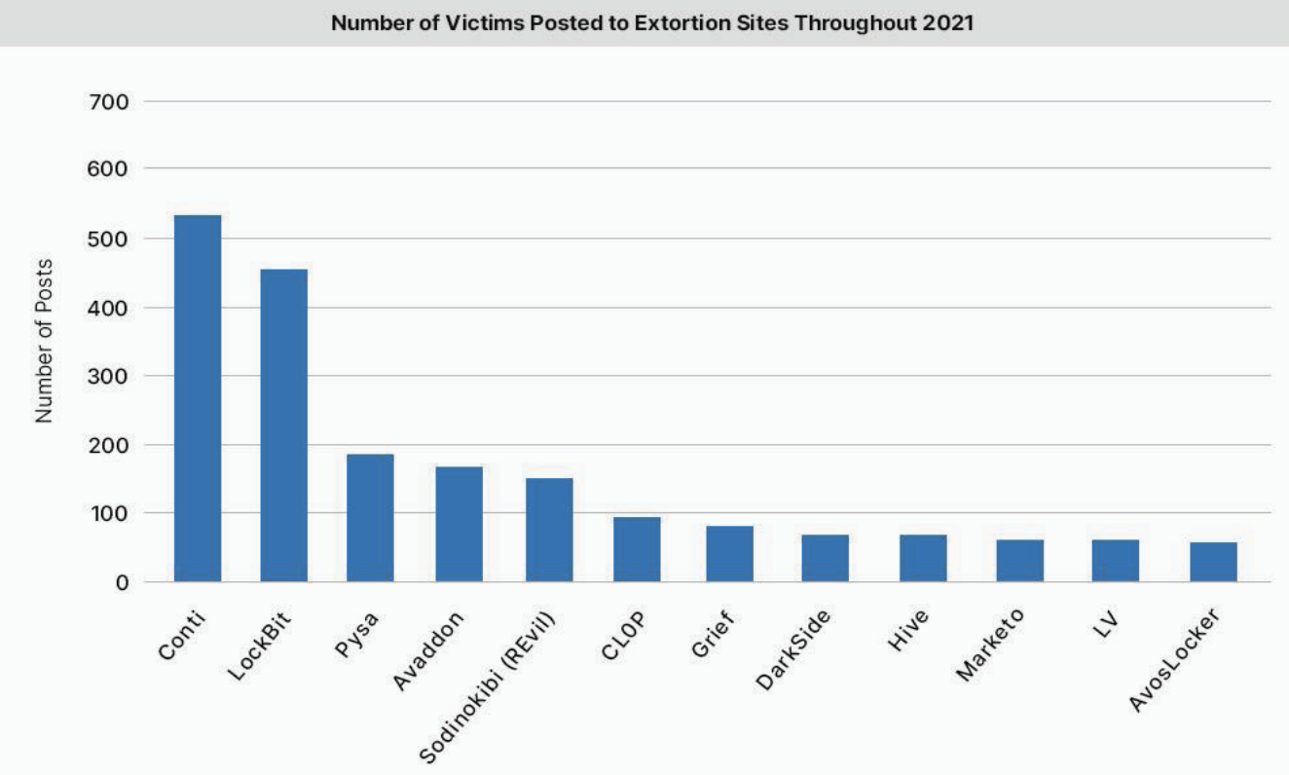
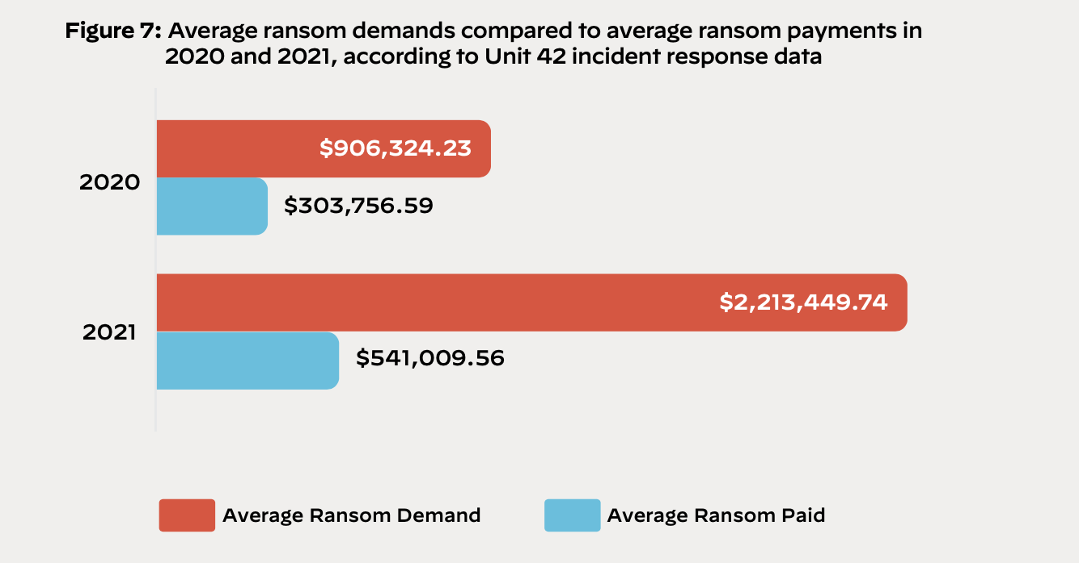
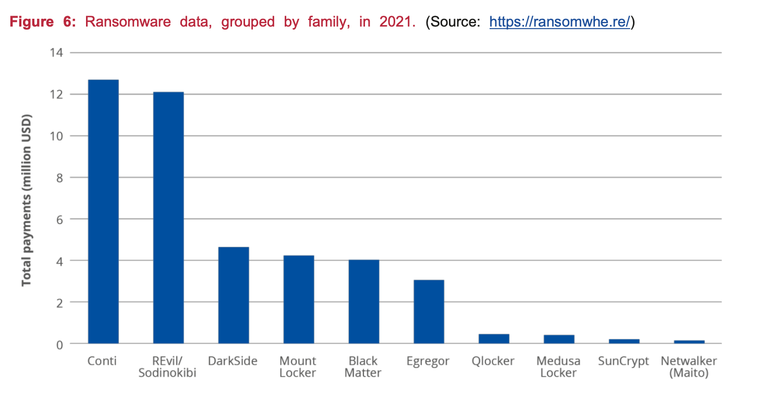
Ransomware Overview
Conti made $12m in 2021
Average top 10 ransomware gang made $4.4m
2,865 victims were announced by 58 different ransomware gangs
Victim organizations in 141 countries
The average ransomware gang extorted around 100 victims
Increased targeting of Manufacturing, Construction, Healthcare, and Wholesale/Retail firms
Average ransom paid was $541k, or 43% less than the initial demand

Slide 16
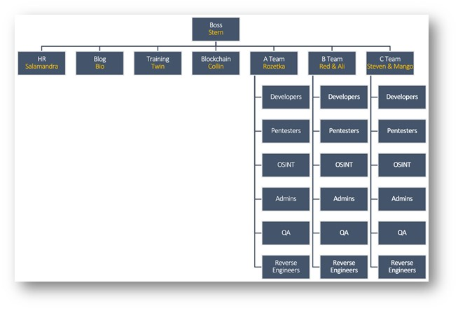
Reasons for Increase
Payment is happening, in multiple forms
Double and triple extortion
Hyper efficiency of ransomware gangs
Corporate structure
Compounding expansion of attack surface
Continued shelter from supporting countries

Slide 17

Ransomware - Defenses
Patch known initial access CVEs
41 common CVEs per Palo Alto
Implement network segmentation
Implement backups
Bonus: with immutable storage
Block what you don’t use or need where you can
Lock down active directory and GPO
Domain admin should not be an every day account
Clean up your attack surface
Do some form of credential management
Minimum: don’t reuse passwords
Use multiple forms of security tools
Microsoft Defender is included and effective
Enlist help!
Get security services in place, participate in sharing communities
Use guidance provided by consulting firms like Mandiant or gov orgs like CISA
Don’t pay the ransom
Use a negotiator to lower your price
Notes:
1a.
CVE-2017-0199
CVE-2017-11882
CVE-2018-13379
CVE-2019-0604
CVE-2019-0708
CVE-2019-11510
CVE-2019-11634
CVE-2019-5591
CVE-2019-7481
CVE-202-5902
CVE-2020-12271
CVE-2020-12812
CVE-2020-1472
CVE-2020-36198
CVE-2020-5135
CVE-2020-8195
CVE-2020-8196
CVE-2020-8234
CVE-2020-8260
CVE-2021-20016
CVE-2021-20655
CVE-2021-2198
CVE-2021-22893
CVE-2021-22941
CVE-2021-22986
CVE-2021-26084
CVE-2021-26855
CVE-2021-2701
CVE-2021-27102
CVE-2021-27103
CVE-2021-27104
CVE-2021-28799
CVE-2021-31166
CVE-2021-31207
CVE-2021-34473
CVE-2021-34523
CVE-2021-36942
CVE-2021-38647
CVE-2021-40444
CVE-2021-40539
CVE-2021-45046
8. https://www.cisa.gov/stopransomware/resources
https://www.mandiant.com/sites/default/files/2021-10/wp-ransomware-protection-and-containment-strategies_%281%29.pdf

Slide 18
You’ve Been Encrypted – What Next?
Start incident response plan immediately
Don’t panic
Isolate infected assets or networks
Identify attack infrastructure and start blocking
Identify what may have been taken out of your organization
Begin looking for initial access point
Monitor for mentions of your company
Begin restoring from backups in safe areas
Only if you think the threat has been neutralized
Engage a trusted negotiator if you need to avoid a leak
This is never a guarantee
Conduct a formal after action review
Define what happened and how to prevent it from happening again
Tell your story to trusted partners
Silence is deadly

Slide 19
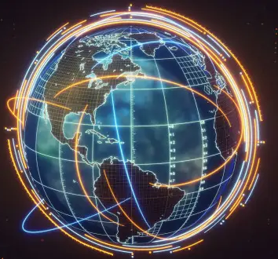
Geopolitical Threats and You
(every action has an equal reaction)
Whether you like it or not, shifts in geopolitical landscapes can impact you
Cyber attacks are hard to attribute, and easy to launch
Industry matters:
State sponsored groups target critical infrastructure
Internet Service Provider
Energy
Water
State sponsored groups target universities
Where you do business matters
Safe countries will continue shielding cyber threat actors

Slide 20
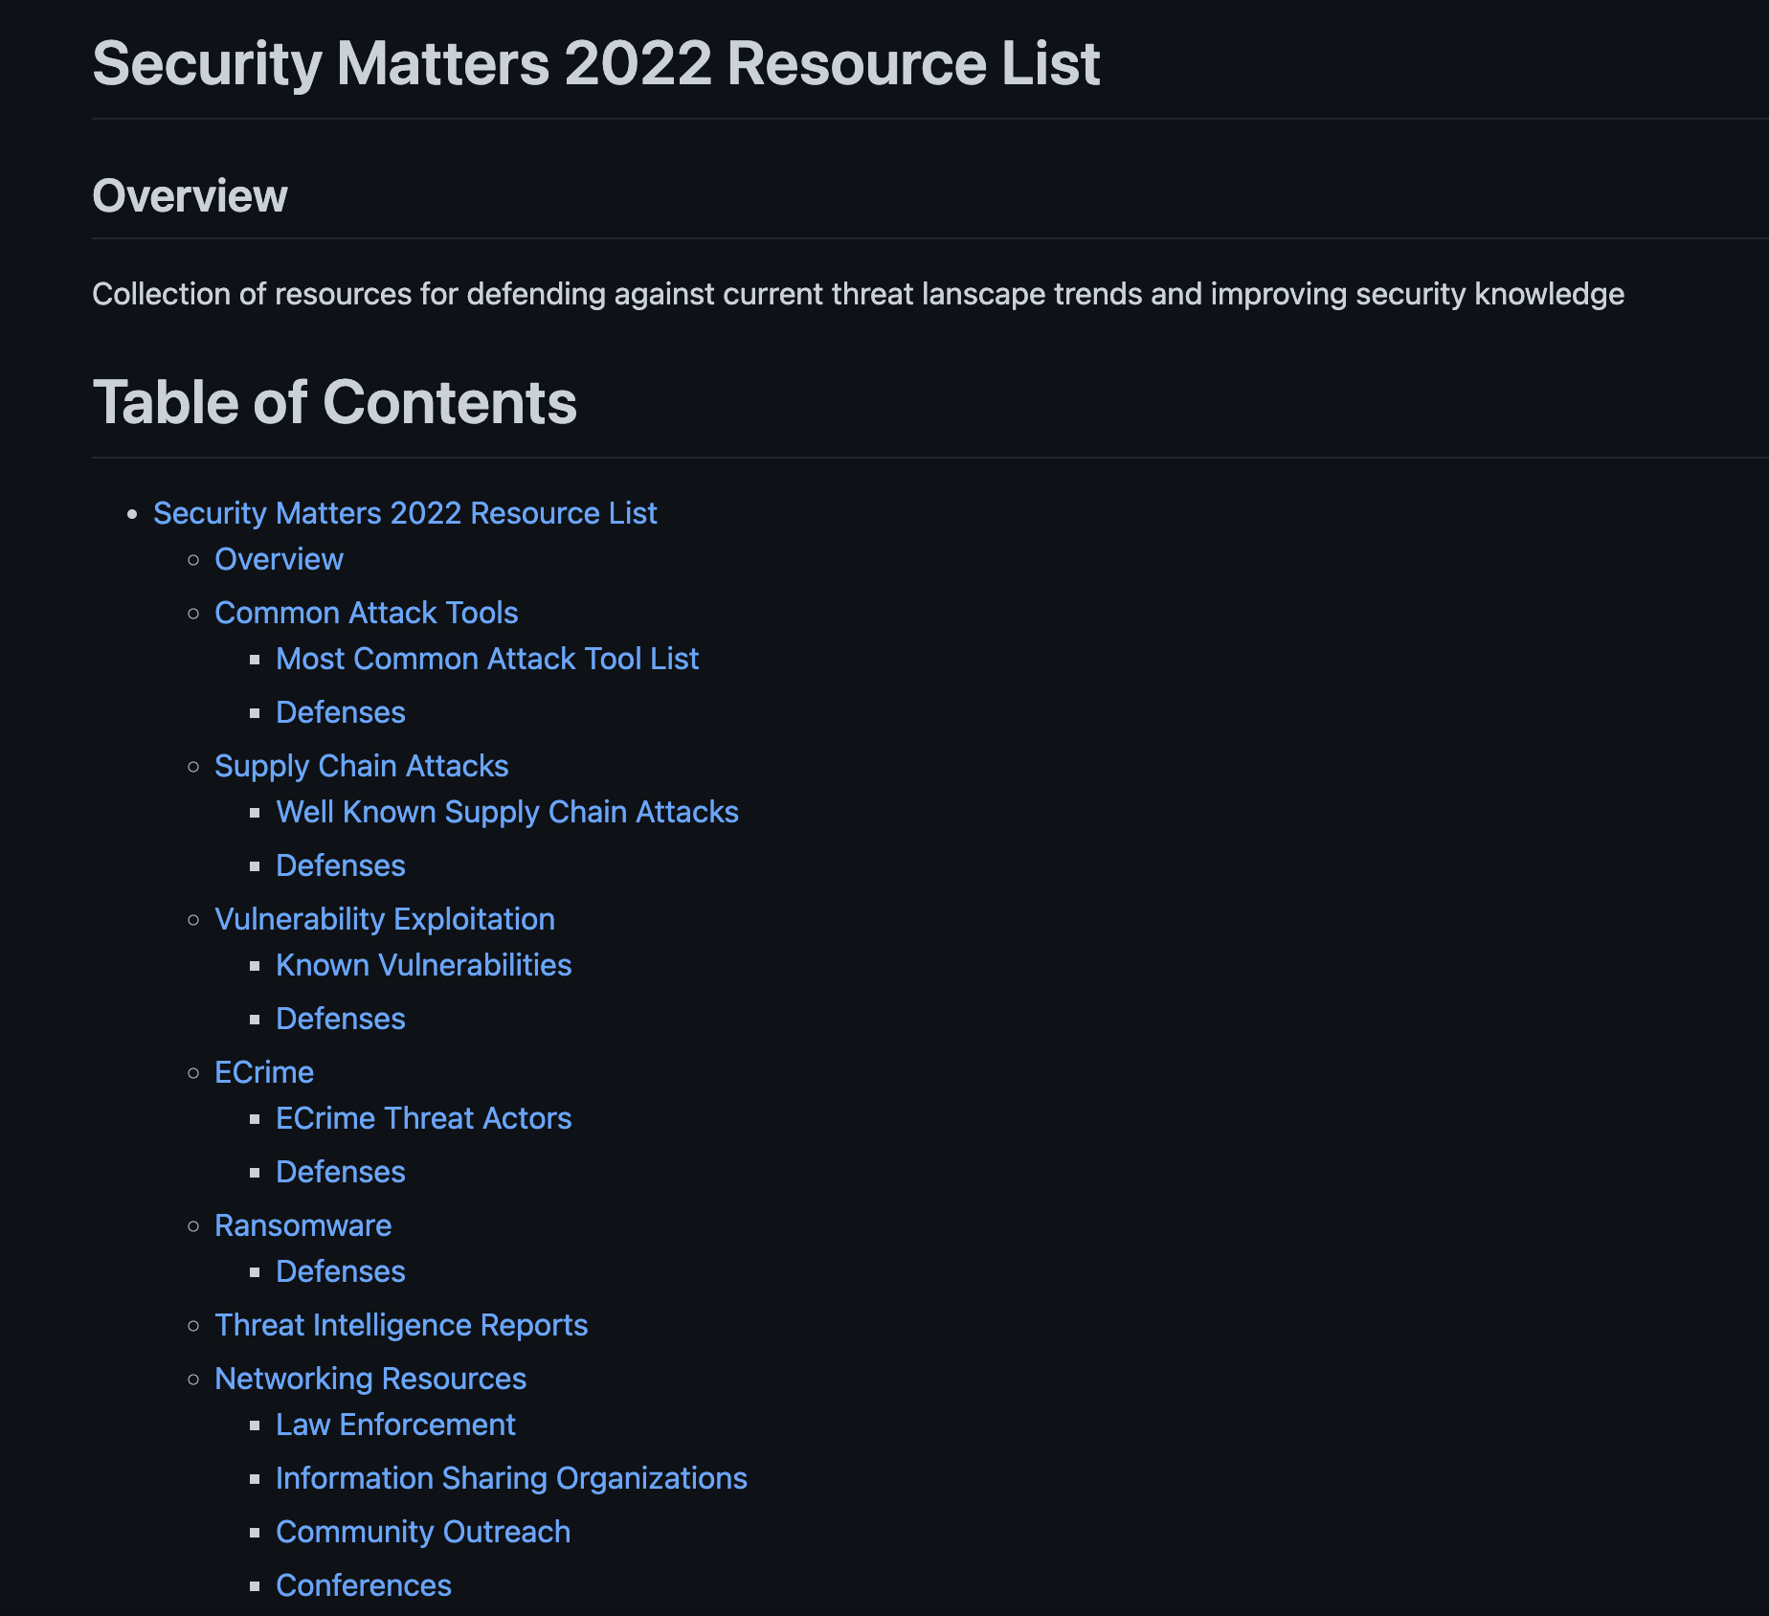
https://github.com/triw0lf/Security-Matters-22/blob/main/README.md https://tinyurl.com/msu-pod-homework
Notes:
All the links on a Github page for reference

Slide 21
Questions?
Find me on socials @jotunvillur on Twitter, Lauren Proehl on LinkedIn, or email at lauren@laurenproehl.com
Special thanks to my team at Marsh McLenann!

